Slide 1
Analysis of Glassdoor Reviews for competitors – Moody’s

Slide 2
Agenda
Executive Summary
Overall word cloud for Pros and Cons
What people liked (based on 5 star ratings)
What people liked (based on 4 star ratings)
What people liked (based on 3 star ratings)

Slide 3
Executive Summary
Objectives
Scrapping Glassdoor reviews for competitors given by their employees.
Analyzing reviews of competitors
Identify hidden patterns in data about employee engagement.
Key Observations
We scrapped close to 90% of reviews.
Total 780 reviews were analyzed.

Slide 4
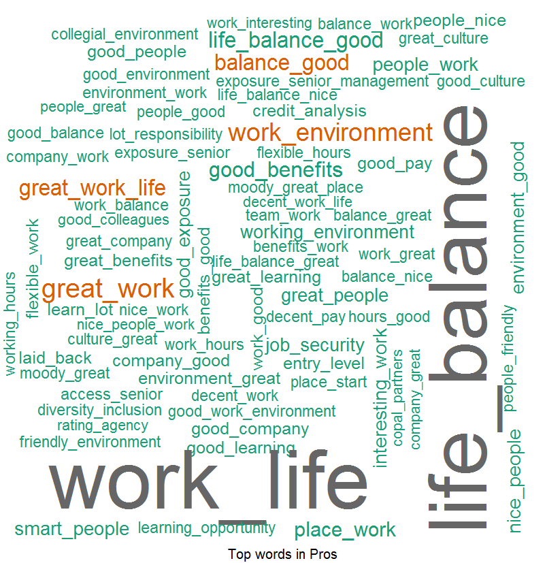
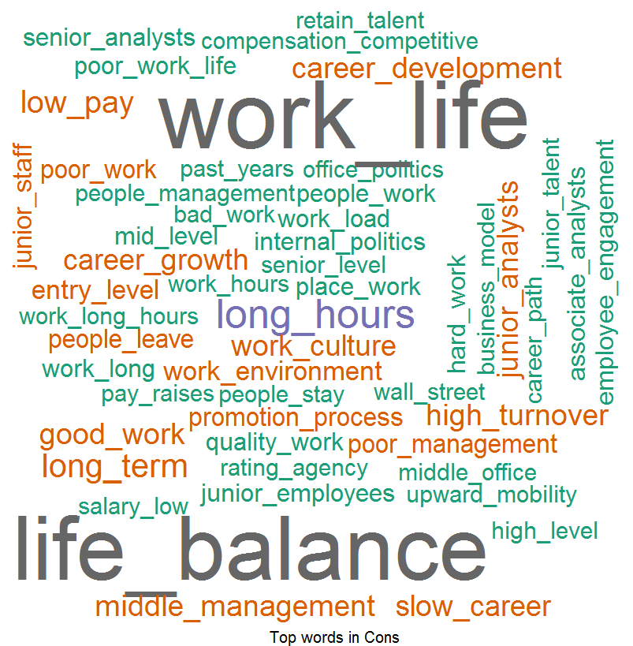
Overall Word Cloud for Pros and Cons
Word Cloud for Pros
Word Cloud for Cons
Good Words List –
Work life balance
Good work
Work environment
Senior management
Good place to work
Good benefits
Word List which people don’t like –
Work life balance
Senior management
Long working hours
Career progression
Low pay
Middle management
High turnover
Work culture

Slide 5
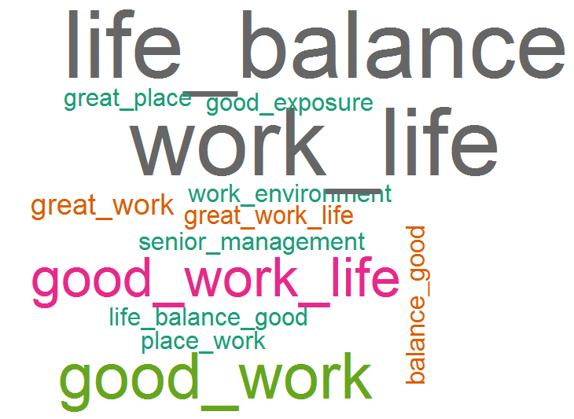
What people liked (based on 5 star ratings)
Word Cloud for Pros
Good Words List –
Work life balance
Good work
Great place to work
Senior management
Good exposure
Work environment

Slide 6
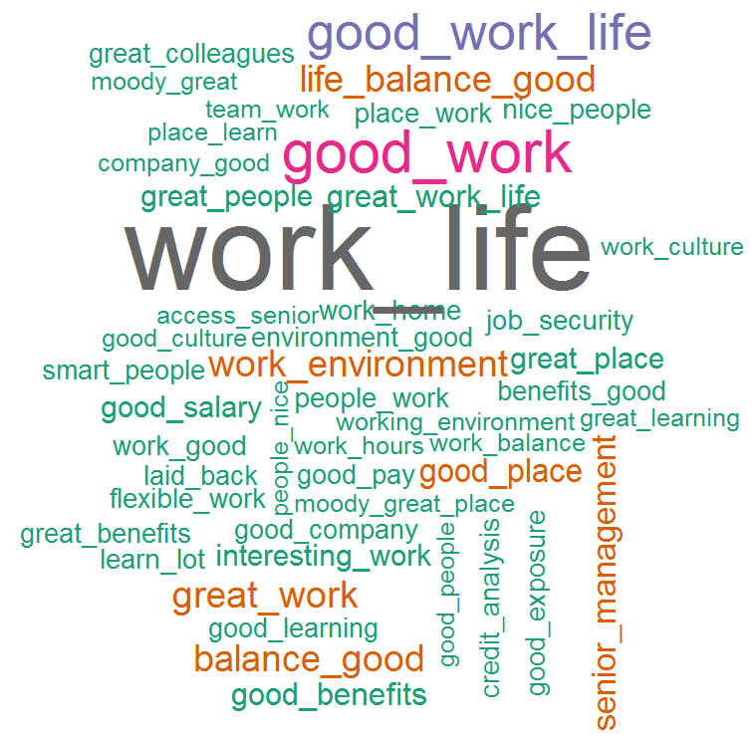
What people liked (based on 4 star ratings)
Word Cloud for Pros
Good Words List –
Work life balance
Good work
Work environment
Senior management
Good benefits
Good salary
Interesting work
Great people
Work from home
Flexible work
Job security
Learning

Slide 7
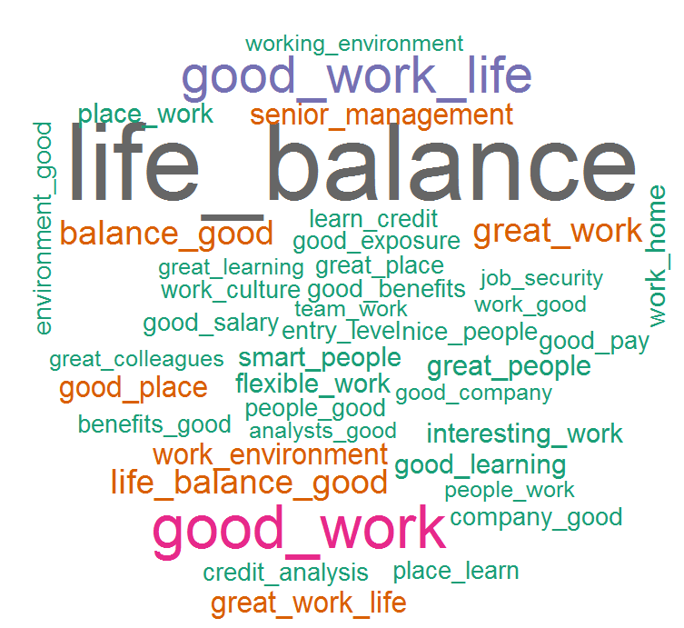
What people liked (based on 3 star ratings)
Word Cloud for Pros
Good Words List –
Work life balance
Good work
Senior management
Work environment
Interesting work
Flexible work
Work from home
Good learning
Smart people
Good salary
Good benefits
Learn credit analysis
Place to learn

